Slide 1

Business Intelligence in Unilever
By Shenesh Perera
IDM-NEGOMBO

Slide 2
Contents
What is BI?
Types of BI tools
BI tools & techniques
Example of BI dashboards
Example of BI OLAP cube
Using BI to find most sold product
BI interface for sales by state and Highest Sold product by quarter
Customized interface for user-friendliness and functional approach
Review of how it meets the business requirement and of customization

Slide 3

What is Business Intelligence?
Notes:
© Copyright Showeet.com – Free PowerPoint Templates

Slide 4
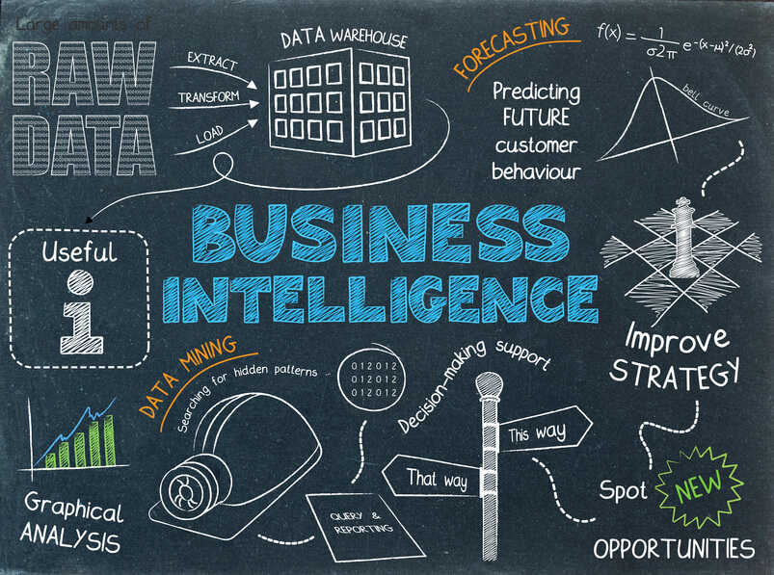
A process that involves the usage of technologies to analyze and present data
The term Business Intelligence (BI) refers to technologies, applications and practices for the collection, integration, analysis, and presentation of business information.
The purpose of Business Intelligence is to support better business decision making.
Essentially, Business Intelligence systems are data-driven Decision Support Systems (DSS).
Business Intelligence is sometimes used interchangeably with briefing books, report and query tools and executive information systems.
Figure 1.0, unsplash.com, 11/04/2018, Paweł Czerwiński
Notes:
Importance of BI:
BI systems provide historical, current, and predictive views of business operations, most often using data that has been gathered into a data warehouse or a data mart and occasionally working from operational data.
Software elements support reporting, interactive “slice-and-dice” pivot-table analyses, visualization, and statistical data mining.
Applications tackle sales, production, financial, and many other sources of business data for purposes that include business performance management.
Information is often gathered about other companies in the same industry which is known as benchmarking.

Slide 5
Types of Business Intelligence Tools
Dashboards
Visualizations
Reports
Data Mining
Online Analytical Processing
Figure 1.1, unsplash.com, 11/04/2018, Paweł Czerwiński
Notes:
Dashboards: A dashboard in business intelligence is a visualization of data. Dashboards are usually created by some external tool, but can also be made manually. The goal of the dashboard is to display in a single screen the business analytics metrics, key performance indicators and important factors related to business data in an organization, department, team or process.
Visualization: Commonly known as information visualization is the process by which information is transformed into a more visual, comprehensible and humanly readable format in order to enable a viewer that is experienced or not to observe, browse or understand the information.
Reports: Reporting is a foundational part of business intelligence which focuses on visualizing data in different types of visualizations such as tables, graphs, and charts. Visualizations within the context of reporting are a graphical representation of data, the goal of which is to accurately present information in a form that is digestible to end users.
Data Mining: Data mining is the process of analyzing data from different sources and then summarizing it into relevant information so that can be used to help increase the revenue and decrease the costs. The primary objective of data mining is to find correlations or patterns among dozens of fields in large databases.
OLAP: The foundation for almost all business intelligence tools, it includes reporting, visualizing, dashboards and doing complex data discovery through data mining. OLAP performs multidimensional analysis of business data and provides the capability for complex calculations, trend analysis, and sophisticated data modeling.

Slide 6
Business Intelligence Tools & Techniques
SAP Business Intelligence Tools
Sisense
Yellowfin Business Intelligence
Microsoft Power Business Intelligence
Tableau
Figure 1.3, unsplash.com, 11/04/2018, Paweł Czerwiński
Notes:
SAP BI Tools: SAP Business Intelligence offers several advanced analytics solutions including real-time BI predictive analytics, machine learning, and planning & analysis. The Business Intelligence platform in particular, offers reporting & analysis, data visualization & analytics applications, office integration and mobile analytics.
Sisense: This user-friendly tool allows anyone within your organization to manage large and complex datasets as well as analyze and visualize this data without your IT department getting involved. It lets you bring together data from a wide variety of sources as well including AdWords, Google Analytics and Salesforce.
Yellowfin BI: Yellowfin BI is a business intelligence tool and “end-to-end” analytics platform that combines visualization, machine learning, and collaboration. You can also easily filter through tons of data with intuitive filtering as well open up dashboards just about anywhere (thanks to this tool’s flexibility in accessibility.
Microsoft Power BI: Microsoft Power BI is a web-based business analytics tool suite which excels in data visualization. It allows users to identify trends in real-time and has brand new connectors that allow you to up your game in campaigns.
Tableau: Tableau is a Business Intelligence software for data discovery and data visualization. With the software you can easily analyze, visualize and share data, without IT having to intervene. Tableau supports multiple data sources such MS SQL, Google Analytics and Sales Force. Tableau is free for personal use.

Slide 7
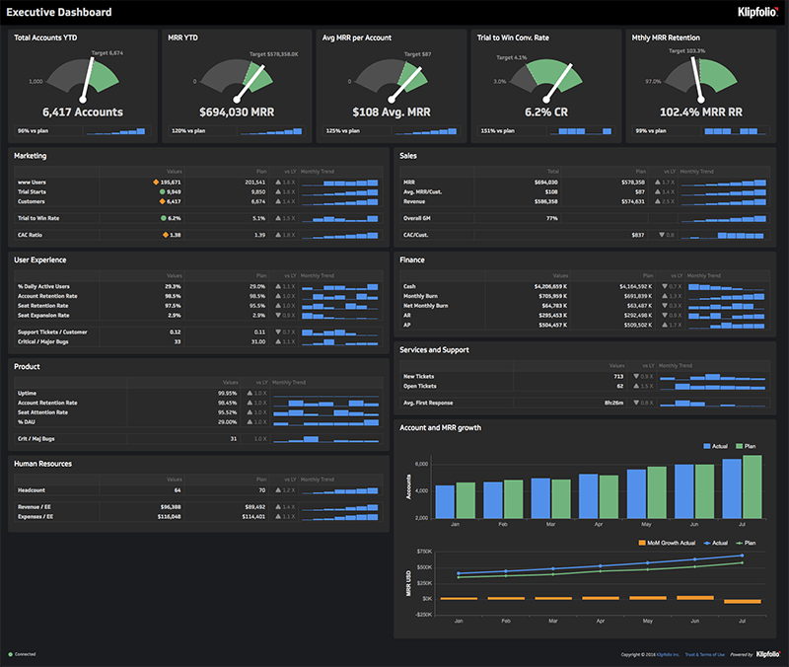
Example of BI dashboards
Notes:
Figure 1.4, klipfolio.com , 21/04/2017, Catalina
A business intelligence dashboard is an information management tool that is used to track KPIs, metrics, and other key data points relevant to a business, department, or specific process. Through the use of data visualizations, dashboards simplify complex data sets to provide users with at a glance awareness of current performance.
The goal of BI dashboards is to help business individuals make more informed decisions by enabling companies to gather, analyze, build dashboards, and create reports on their most important and business-driving data.

Slide 8
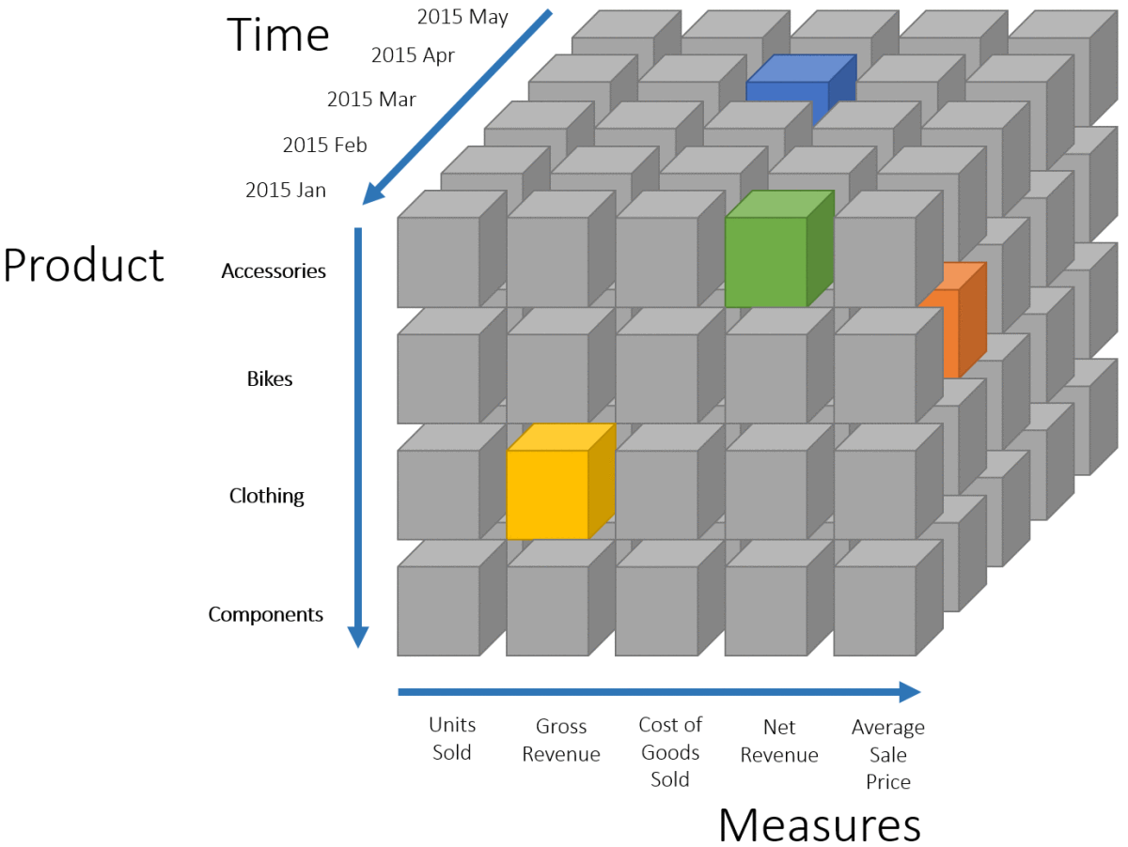
Example of BI OLAP cubes
Notes:
Figure 1.5, mkhernandez.wordpress.com, 21/01/2017, mkhernandez
OLAP is an acronym for Online Analytical Processing. OLAP performs multidimensional analysis of business data and provides the capability for complex calculations, trend analysis, and sophisticated data modeling.
It is quickly becoming the fundamental foundation for Intelligent Solutions including Business Performance Management, Planning, Budgeting, Forecasting, Financial Reporting, Analysis, Simulation Models, Knowledge Discovery, and Data Warehouse Reporting. OLAP enables end-users to perform ad hoc analysis of data in multiple dimensions, thereby providing the insight and understanding they need for better decision making.

Slide 9

Using BI to identify most sold product
Notes:
The business requirement is to find the most sold product in Unilever using business intelligence, first by sales by state and then the highest sold product by quarter. As Unilever is mainly based in USA, the interface will show the information for the USA and it’s state.
There are 4 products that will be evaluated:
Lipton
Axe
Dove
Knorr
Each product’s sales will be taken and then reduced to the amount sold per quarter, and then from this information we will identify the most sold product in USA.

Slide 10
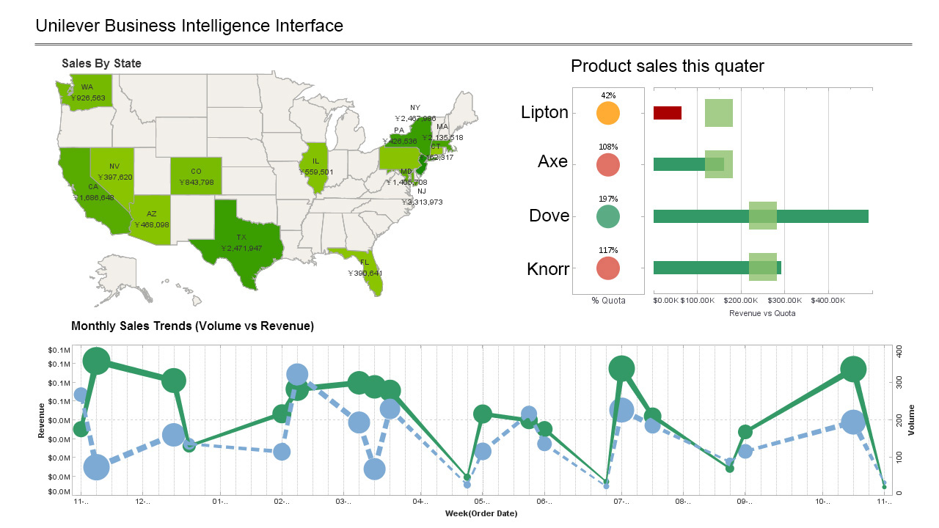
BI interface for sales by state and Highest Sold product by quarter
Figure 1.6, 01/06/2019, Shenesh Perera
Notes:
An Business Intelligence dashboard interface has been used to visualize the products sale rate by state and the sales by quarter.
The sales by state is an overall sales analysis for the 4 products by state, so that means each state generated that particular amount of profit for this quarter, then on the right hand-side with the bar-graph there’s a visualization of sales of each product this quarter.
The green boxes show the minimum sales that product should generate, it is a threshold value. If a product meets this threshold value, that means all the amount of revenue generated beyond that point is profit, any amount behind that point is the cost of producing the product.
The %Quota is the percentage of how much of the overall sales is being generated by each product.
As you see, Lipton has the lowest sales and does not meet the threshold limit so there is a loss in revenue due to Lipton, however though Dove seems to have generated twice the revenue beyond the threshold limit, as such the loss from the Lipton is covered.
From this dashboard it has become apparent that for the next quarter, it is best to produce a lower amount of lipton products and a higher amount of Dove products in order to generate more Revenue per Quota.
However though, there is a problem this interface is not user-friendly and has a lot going on, the next step is to customize this interface and condense the information from these 2 segments into 1 graph.

Slide 11
Customized interface for user-friendliness and functional approach
Notes:
Figure 1.7, 01/06/2019, Shenesh Perera
Now, in order to get a more functional and higher user-friendly visualization of the information in the dashboard, a graph of volume against revenue against weeks is plotted. The green line indicates the sales of Dove products and the blue line indicates the sales of the Lipton products.
As you may see now, it is much more easier to see in a week-based manner that is more functional and is more valuable to draw proper conclusions from to see if actually there is a considerable rate of revenue generated by the most sold product and the least sold product.
This information is condensed in the graph and is much more easier to understand, which improves the functionality of this business intelligence tool as now a larger audience can be caught using this business intelligence tool.

Slide 12
Review of how it meets the business requirement and of customization
The highest sold product is obviously visible and is proven to be the highest sold product due to a more precise overview of revenue per week.
The customization of the business intelligence tool improved the functionality by allowing a larger audience to understand that Dove products are being sold more and Lipton products are being sold less.
It has become very easy to identify what products must be produced more for the next quarter.
It has become very easy to gauge the expectations, threshold limits and average revenue generated per state per week.
Notes:
The design was made with high end efficiency and the complete understanding that Unilever is somewhat new to Business Intelligence, which is why the business intelligence tool that has been designed is a dashboard. A dashboard is very straightforward and visualizes data in a very comprehensible and appealing manner.
The business requirement was to identify the most sold product in unilever, all the products that were considered were evaluated and then visualized in the dashboard appropriately. The business requirement was met successfully as with the business intelligence tool that has been designed it is very easy to say which product has been sold the most. In addition to this information, we also have information about other rival products too, there is very peculiar analysis done to understand how much revenue is made for products overall by state and then per product for this quarter.
This information can be perfectly utilized due to high user-friendliness and higher functionality, as any target audience can simply with one look of the business intelligence tool come to the conclusion of knowing which product is being sold the most.
The customization, the addition of the revenue to volume to week line graph added some very much needed user friendliness as the other 2 components are quite complex to understand and also includes information of 2 products that we do not need to compare. The customization integrated to the design is what I believe made the business intelligence tool more efficient and flexible, as a result of this business requirement was met more satisfactorily.

Slide 13

THANK YOU
Shenesh Perera
IDM- NEGOMBO
Business Intelligence
K.P.I. Shenesh Perera

